Slide 1
Network Security
CS 6823 – Lecture 2
Attacks - Network Recon and Scanning
Phillip Mak
pmak@nyu.edu
CS 6823 - Network Security
1

Slide 2
Exploiting Systems – Why Teach?
Much controversy over teaching “how to hack”
Why should we learn this?
You have to know how networks are attacked in order mount an effective defense.
“Know your enemy”
However, with this knowledge comes responsibility.
Much like if you learn how to fire a weapon you only do it at the pistol range not in the middle of the street.
Likewise, skills taught here are to only be used in the confines of a controlled computer security research lab.
If you go out and do something stupid – you will end up in jail.
CS 6823 - Network Security
2
Notes:
Learning hacking -> Learning how to think like an attacker, understand tools, and defend against attackers

Slide 3
Some Additional Words of Caution
General Assumption = Bypassing a protection is illegal
Penetration testing is bypassing protections with explicit written PERMISSION from the owner of the system.
However, in Germany and France and some other EMEA countries place the development or possession of “attack” tools as illegal.
Legal advice is critical (this slide is not legal advice)
CS 6823 - Network Security
3

Slide 4
Types of Attacks and Computer Crimes
Denial of Service
Destruction of Information
Dumpster Diving
Emanation Eavesdropping
Embezzlement
Espionage
Fraud
Information Warfare
Illegal Content or Material
Malicious Code
Masquerading
Social Engineering
Software Piracy
IP Address Spoofing
Terrorism
Theft of Passwords
Use of exploit scripts
Network Intrusions
See notes section for definitions
CS 6823 - Network Security
4
Notes:
Denial of Service – taking a service such as a website online
Destruction of Information
Dumpster Diving – obtaining information from the trash
Emanation Eavesdropping – radio waves, such as BT keyboards
Embezzlement – stealing money
Espionage – stealing information
Fraud – lying/deception for unlawful gain
Information Warfare – propaganda, causing distrust of own’s systems
Illegal Content or Material
Malicious Code – General term for anything bad software
Masquerading – Pretending to be someone else (person, PC, service)
Social Engineering

Slide 5
Why?
Fame
Not so much anymore (more on this with Trends)
Money
The root of all evil…
War
A battlefront just as real as the air, land, and sea
Mar 20, 2013 - The computer networks of three major South Korean banks and three television networks went offline nearly simultaneously at 2pm Seoul time on Wednesday, according to South Korea's National Police Agency. The government confirmed that malware was used to bring the networks down, and it is looking into whether North Korea is behind the attack.
CS 6823 - Network Security
5

Slide 6
US Federal Computer Crime Laws (consult legal council for official advice)
Note: The following slides (7-9) on laws is to facilitate discussion only. There is no need to memorize any of these details.
1970 US Fair Credit Reporting Act (FCRA) – Regulates the collection, dissemination and use of consumer credit information, amended several times
1970 US Racketeer Influenced and Corrupt Organization Act (RICO) – extends criminal and civil penalties for acts performed as part of a criminal organization
1973 Code of Fair Information Practices. Five underlying principals:
No personal data recordkeeping systems whose existence is secret. (transparency)
Must be a way for a person to find out what information about them is in a record and how it is used. (individual participation)
There must be a way for a person to prevent information obtained for a specific purpose from being used for another purpose without the subjects consent. (purpose limitation)
There must be a way for a person to correct a record of information about them. (integrity)
Any organization creating, maintaining, using or disseminating records of personal data must assure the reliability of the data and take prudent measures to protect this data. (integrity)
CS 6823 - Network Security
7
Notes:
FCRA – credit report, require consent
RICO – increase penalities for mafia

Slide 7
US Federal Laws (cont)
1974 US Privacy Act – Who is allowed to have access to information that contains identifying info (education, criminal, medical records – but no limited to)
1978 Foreign Intelligence Surveillance Act (FISA) – Covers electronic surveillance of foreign intelligence organizations.
1986 US Computer Fraud and Abuse Act (amended in 1996) – covers malicious threats, attacks and unauthorized access to computer systems. Penalties increases with Patriot Act.1987
1994 US Communications Assistance for Law Enforcement Act – This law requires all communications carriers to provide a facility for law enforcement to provide wiretaps.
CS 6823 - Network Security
7
Notes:
Privacy Act – how information can be disclosed, keep records of disclosure, minimalize data collection, limits sharing between gov’t agencies, violations
FISA – amended numerous times, for surveillance of foreigners within the U.S.
CFAA – accessing or using a computer without authorization, interstate
CALEA – allows gov’t to tap telecommunications

Slide 8
US Federal Laws (cont)
1996 Health Insurance and Portability Accountability Act (HIPPA – Amended in 2000) - Protecting personal information in the health insurance industry.
1996 Title 1, Economic Espionage Act – Make theft of trade secrets a crime
1998 US Digital Millennium Copyright Act (DMCA) – prohibits the manufacturing, trading or selling of any technology, device or service design to circumvent copy protection mechanisms
CS 6823 - Network Security
8
Notes:
DMCA – ripping DVD, even if encryption is nominal

Slide 9
US Federal Laws (cont)
US Uniform Computers Information Transactions Act (UCITA) – covers software licensing, online access and other transaction between computer systems. Validates “shrink wrapped licensing”
2000 US Congress Electronic Signatures in Global and National Commerce Act (ESIGN) – legal foundation for electronic signatures and records
2001 USA Provide Appropriate Tools Required to Intercept and Obstruct Terrorism (PATRIOT) Act – Extends the ability of law enforcement to search electronic records.
2002 E-Govt Act Federal Information Security Management Act (FISMA) – improve security of computer networks in the federal government.
CS 6823 - Network Security
9
Notes:
UCITA –
PATRIOT ACT – extend gov’t to search electronic records without warrants
FISMA – forces the gov’t to do info sec

Slide 10
Network Attack Methodology
Recon – Information gathering
Scanning – Enumeration
Identify Hosts
Vulnerability Identification
Exploitation
Gaining access
Elevating given access
Application/Web level attacks
Denial of Service (DOS)
Post Exploitation –
Maintaining Access
Removing Forensic Evidence
Exfiltration
TODAY’S LECTURE
CS 6823 - Network Security
10
Notes:
route-server>sh ip route 128.238.0.0
Routing entry for 128.238.0.0/16
Known via "bgp 4323", distance 200, metric 0
Tag 7018, type internal
Last update from 168.215.52.202 5d10h ago
Routing Descriptor Blocks:
* 168.215.52.202, from 168.215.52.203, 5d10h ago
Route metric is 0, traffic share count is 1
AS Hops 2
route-server>tracert 128.238.2.92
^
% Invalid input detected at '^' marker.
route-server>trace 128.238.2.92
Type escape sequence to abort.
Tracing the route to duke.poly.edu (128.238.2.92)
1 ge-0-3-0-514.dnvr.twtelecom.net (66.162.47.57) 0 msec 0 msec 0 msec
2 peer-01-so-1-0-0-0.dlfw.twtelecom.net (66.192.246.53) 16 msec 16 msec 16 msec
3 cr2.dlstx.ip.att.net (12.122.138.18) [AS 7018] 52 msec 56 msec 52 msec
4 cr1.attga.ip.att.net (12.122.28.173) [AS 7018] 56 msec 52 msec 56 msec
5 cr2.wswdc.ip.att.net (12.122.1.174) [AS 7018] 56 msec 56 msec 56 msec
6 cr2.n54ny.ip.att.net (12.122.3.37) [AS 7018] 56 msec 56 msec 56 msec
7 gar2.nylny.ip.att.net (12.122.130.49) [AS 7018] 52 msec 56 msec 52 msec
8 12.116.102.22 [AS 7018] 60 msec 56 msec 56 msec
9 42ce7023.unknown.oainc.net (66.206.112.35) [AS 23329] 156 msec 56 msec 56 msec
10 65.77.177.90 [AS 23329] 56 msec 56 msec 60 msec
11 duke.poly.edu (128.238.2.92) [AS 23329] 60 msec 60 msec 60 msec
12 duke.poly.edu (128.238.2.92) [AS 23329] 60 msec 60 msec 60 msec

Slide 11
RECON - INFORMATION GATHERING
CS 6823 - Network Security
11

Slide 12
Network Attack Methodology
Recon – Information gathering
Scanning – Enumeration
Identify Hosts
Vulnerability Identification
Exploitation
Gaining access
Elevating given access
Application/Web level attacks
Denial of Service (DOS)
Post Exploitation –
Maintaining Access
Removing Forensic Evidence
Exfiltration
CS 6823 - Network Security
12
Notes:
route-server>sh ip route 128.238.0.0
Routing entry for 128.238.0.0/16
Known via "bgp 4323", distance 200, metric 0
Tag 7018, type internal
Last update from 168.215.52.202 5d10h ago
Routing Descriptor Blocks:
* 168.215.52.202, from 168.215.52.203, 5d10h ago
Route metric is 0, traffic share count is 1
AS Hops 2
route-server>tracert 128.238.2.92
^
% Invalid input detected at '^' marker.
route-server>trace 128.238.2.92
Type escape sequence to abort.
Tracing the route to duke.poly.edu (128.238.2.92)
1 ge-0-3-0-514.dnvr.twtelecom.net (66.162.47.57) 0 msec 0 msec 0 msec
2 peer-01-so-1-0-0-0.dlfw.twtelecom.net (66.192.246.53) 16 msec 16 msec 16 msec
3 cr2.dlstx.ip.att.net (12.122.138.18) [AS 7018] 52 msec 56 msec 52 msec
4 cr1.attga.ip.att.net (12.122.28.173) [AS 7018] 56 msec 52 msec 56 msec
5 cr2.wswdc.ip.att.net (12.122.1.174) [AS 7018] 56 msec 56 msec 56 msec
6 cr2.n54ny.ip.att.net (12.122.3.37) [AS 7018] 56 msec 56 msec 56 msec
7 gar2.nylny.ip.att.net (12.122.130.49) [AS 7018] 52 msec 56 msec 52 msec
8 12.116.102.22 [AS 7018] 60 msec 56 msec 56 msec
9 42ce7023.unknown.oainc.net (66.206.112.35) [AS 23329] 156 msec 56 msec 56 msec
10 65.77.177.90 [AS 23329] 56 msec 56 msec 60 msec
11 duke.poly.edu (128.238.2.92) [AS 23329] 60 msec 60 msec 60 msec
12 duke.poly.edu (128.238.2.92) [AS 23329] 60 msec 60 msec 60 msec

Slide 13
Reconnaissance
“Casing the joint”
Gather as much information as possible about the target from open sources
Bank robbers will typically perform reconnaissance on the branch. Will observe times when the branch is busy with customers, guard shift changes, location of cameras, etc.
This is the same first step performed in computer network attacks.
CS 6823 - Network Security
13

Slide 14
What are we trying to get?
IP addresses
Network Topology
Domain Names
User Account Names
Operating systems and software being used
Security Policies: password complexity requirements, change policy
Physical security systems
Home addresses of employees
Frequent hangouts of employees
And more
CS 6823 - Network Security
14

Slide 15
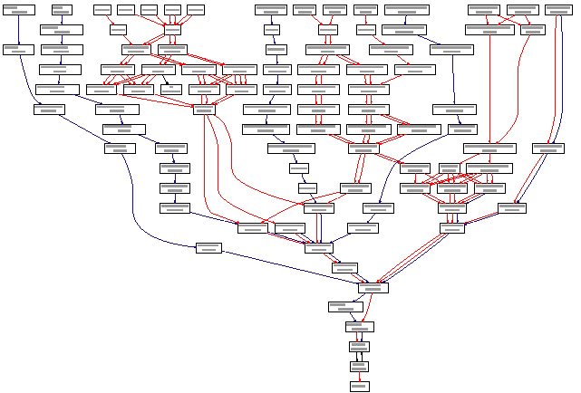
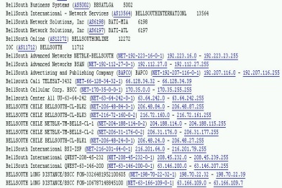
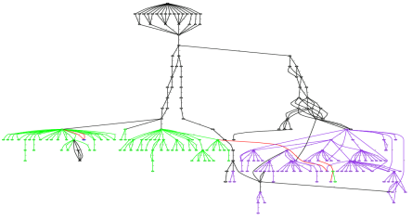
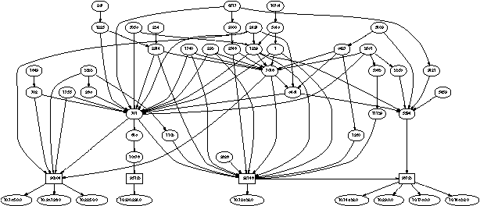
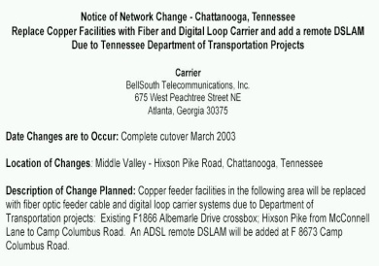
Network Reconnaissance
1
Collect Public Information
2
3
4
Probe the Target Networks
Path Map
Public Databases
Logical
Topology Map
News,
Press
Releases
ASN Map
Run Automated Tools/Processes
Pre-Processing
Network, Host and Services tools
Post Processing
Data Base
Mapping
Produce Maps
Send crafted IP packets to IP addresses and infer network characteristics from returned data
Search Internet for target network related information
4
3
Service
Discovery
2
Host
Discovery
5
Analyze Data
Network
Discovery
Topology Details Analysis
1
5
Paths
Analysis
Public
Information
Sources
Network Mapping and Analysis
Process
Analysis
Application
Analysis
Area 1
Area 2
6
Loc6-R2
SP2
Loc5-R1
Loc11-R1
SP1
ISP1
Loc1-R2
Recursion
xxx.vvv.127.68
xxx.www.2.174
xxx.www.164.51
Loc4-R1, R2
SP1
ISP2
SP1 Backbone
SP2
SP3
Loc8-R3
xxx.uuu.74.169
xxx.zzz.216.145
xxx.www.122.69
Loc3-R1
Loc4-R1
SP 1
SP 2
SP 2
Loc3-R4
sp2
ISP3
SP7
Gateway Network
Area 1
sp2
SP3
SP6
Loc9-R1
xxx.yyy.10.10
xxx.yyy.17.18
Loc8-R1, R2
xxx.yyy.10.6
xxx.yyy.10.74
xxx.yyy.18.102
SP9
Loc15-R1
xxx.yyy.10.110
xxx.yyy.10.114
xxx.yyy.18.98
xxx.yyy.12.9
xxx.yyy.10.42
xxx.yyy.10.118
xxx.yyy.10.86
sp3
Loc2-R1
6
xxx.yyy.12.33
Loc10-R1
ISP4
Cisco
xxx.yyy.10.122
xxx.yyy.10.106
Cisco
SP8
xxx.yyy.12.18
Cisco
Cisco
xxx.yyy.10.50
xxx.yyy.10.81
xxx.yyy.12.241
Cisco
Cisco
Cisco
Cisco
Cisco
Loc14-R2
xxx.yyy.12.yyy
xxx.yyy.12.65
xxx.yyy.12.129
xxx.yyy.12.161
xxx.yyy.12.193
xxx.yyy.12.225
Loc13-R2
sp5
SP11
SP10
Loc8-R2
Recursively discover additional network structure
xxx.yyy.12.1
xxx.yyy.12.49
Cisco
Cisco
Cisco
Cisco
ISP5
xxx.yyy.12.20
Cisco
Cat 1900
Cisco
Cat 1900
xxx.yyy.12.34
xxx.yyy.12.209
Cisco
Cat 1900
xxx.yyy.12.113
xxx.yyy.12.145
xxx.yyy.12.177
SP12
Loc6-R1
xxx.yyy.12.98
Cisco
Cat 1900
Cisco
Cat 1900
Loc6-R1
sp6
xxx.yyy.12.2
xxx.yyy.12.226
Loc13-R1
xxx.yyy.12.22
xxx.yyy.12.37
xxx.yyy.12.130
DNS Names
AAGK1
VTVGK1
AAGW1
Cisco
Cisco
Cat 1900
ISP5
SP13
SP16
xxx.yyy.12.100
xxx.yyy.12.81
xxx.yyy.12.162
xxx.yyy.12.228
xxx.yyy.12.24
FFGW1
Cisco
Cat 1900
LLGW1
xxx.yyy.12.3
xxx.yyy.12.132
xxx.yyy.12.194
Loc3-R6
sp7
AAGK2
BILLING
AAGW2
City 5
HHGW1
Cisco
Cat 1900
SP14
SP15
Loc8-R4
xxx.yyy.12.26
FFGW2
xxx.yyy.12.164
City 14
ISP7
xxx.yyy.12.4
City 7
JJGW1
LLGW2
BILLING2
VTVG1
HHGW2
xxx.yyy.12.196
Loc3-R2
xxx.yyy.12.6
City 9
KKGW1
Loc3-R3
Cisco
Cat 1900
JJGW2
DBCLIENT
VTVG2
xxx.yyy.12.66
City 11
Cisco
Cat 1900
City 1
KKGW2
xxx.yyy.12.242
xxx.yyy.12.7
xxx.yyy.12.69
BILLINGDB
GGGW1
Cisco
Cat 1900
xxx.yyy.12.114
xxx.yyy.12.244
DNS Name
IP Address
DNS Resolution
MMGW1
xxx.yyy.12.210
xxx.yyy.12.82
Cisco
Cat 1900
AAVNM1
City 3
Cisco
Cat 1900
GGGW2
xxx.yyy.12.116
xxx.yyy.12.146
Cisco
Cat 1900
xxx.yyy.12.178
City 13
RRGW1
Cisco
Cat 1900
MMGW2
Cisco
Cat 1900
xxx.yyy.12.212
iocecweb1.spco.com
123.22.68.248
worked
xxx.yyy.12.50
xxx.yyy.1284
xxx.yyy.12.148
PPGW1
DDGW1
City 6
xxx.yyy.12.180
RRGW2
EEGW1
Data Fusion analysis of maps, returned probe data and collected public information
iocecweb2.spco.com
123.22.68.249
worked
xxx.yyy.12.53
NNGW1
City 12
BBGW1
City 4
PPGW2
iocecweb3.spco.com
-
-
DDGW2
City 8
City 10
City 2
EEGW2
NNGW2
iocecweb4.spco.com
123.22.68.74
worked
BBGW2
connectandcreate.spco.com
123.22.64.4
worked
connectandcreate1.spco.com
-
connectandcreate2.spco.com
123.22.64.29
worked
connectandcreate3.spco.com
-
connectandcreate4.spco.com
-
connectandcreate5.spco.com
-
connectandcreate6.spco.com
-

Slide 16
Low Tech Recon
Public Information Sources
Public Databases
Dumpster Diving
Shred your documents
Social Engineering
Educate your users about giving out sensitive or confidential information over the phone. Caller-id DOES NOT provide authentication
Physical Break Ins
You can have the best, multimillion dollar security system on the market but it will be useless if you don’t lock the front door.
CS 6823 - Network Security
16

Slide 17

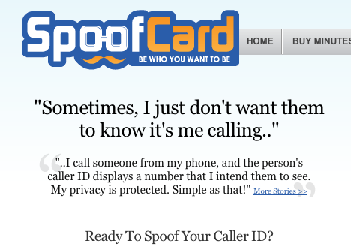
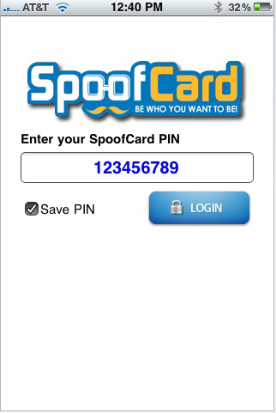
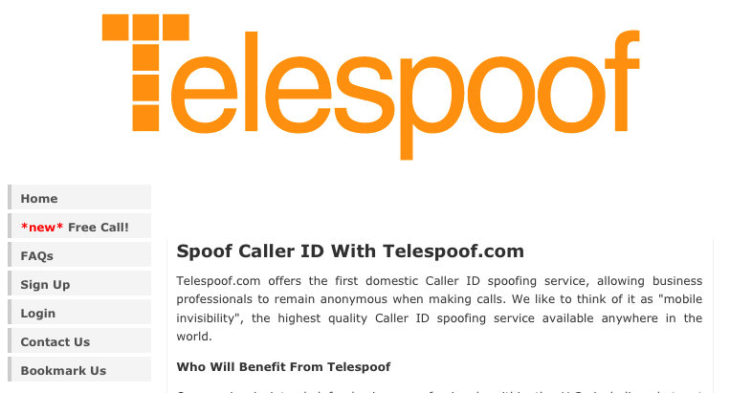
Changing Caller-ID is Easy
There are legitimate reasons to do this.
For example, I work from home often. When I call business associates from home I would like my “work” number displayed.
Has been around for a long time but used to require dedicated PRI lines and expensive equipment
Now can setup Asterisk server (free and open source) and signup for a very low cost VoIP trunking provider. Just need a spare PC and broadband connection.
Or even easier:
CS 6823 - Network Security
17

Slide 18
Useful Google Searches
“site:” directive – searches only within a given domain
site:poly.edu
“link:” directive – shows all sites linked to the specified site.
link:www.poly.edu
“intitle:” – shows pages whose title matches the search criteria.
“inurl:” – shows pages whose URL matches the search string
“related:” – shows similar pages.
CS 6823 - Network Security
18

Slide 19
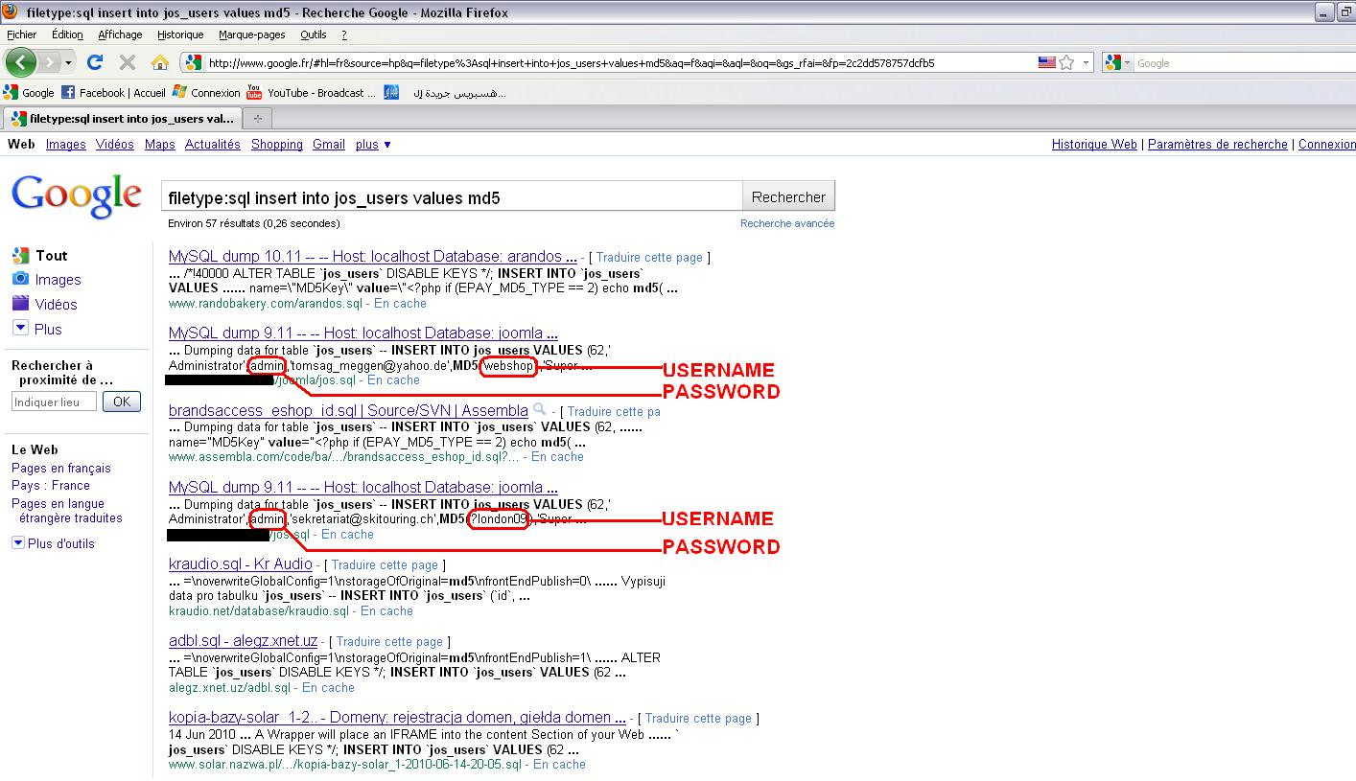
Google search of
filetype:sql “insert into jos_users values” md5
CS 6823 - Network Security
19

Slide 20
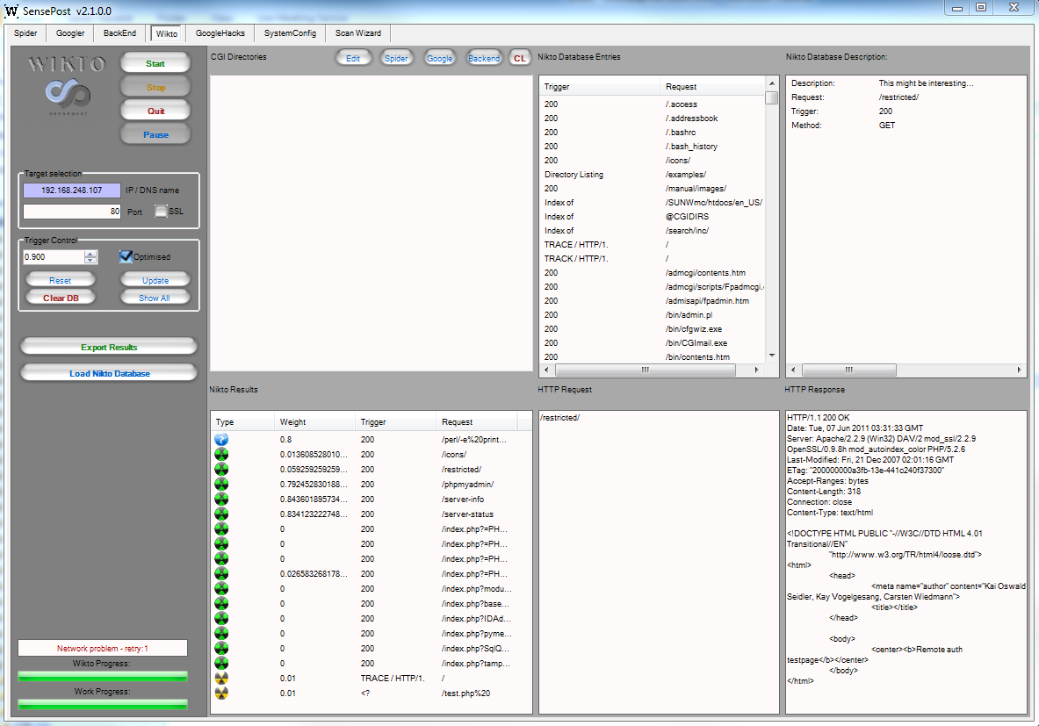
Google Recon Automated
Foundstone SiteDigger
(http://www.mcafee.com/us/downloads/free-tools/sitedigger.aspx)
Wikto by Sensepost
(http://www.sensepost.com/labs/tools/pentest/wikto)
CS 6823 - Network Security
20

Slide 21
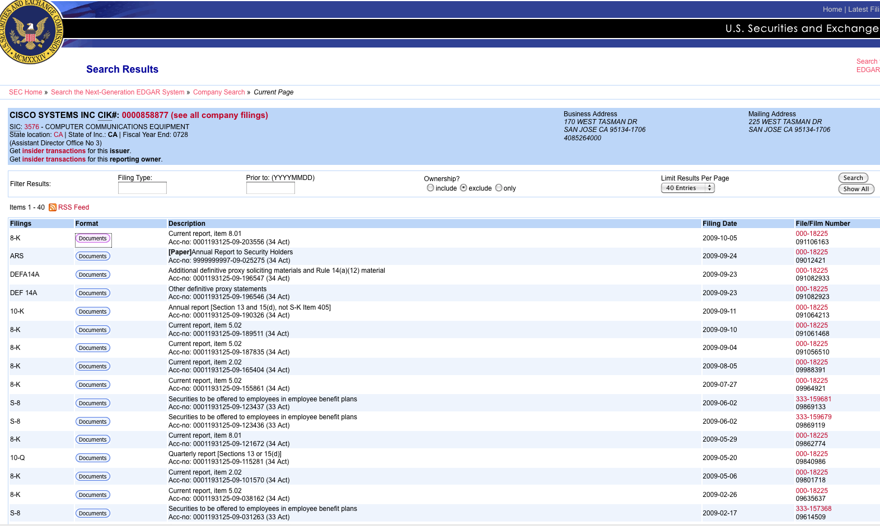
Edgar Database – www.sec.gov
If the company is public traded the Edgar database can be a valuable resource
CS 6823 - Network Security
21

Slide 22
Maltego
Information gathering tool which visually displays the relationship between information.
Domain Names
Whois Information
DNS Names
Netblocks
IP Addresses
Also allow for the enumeration of people
Email addresses
Web sites associated with a person
Phone numbers associated with a person's name
Social groups that are associated with a person
Companies and organizations associated with a person
CS 6823 - Network Security
22

Slide 23
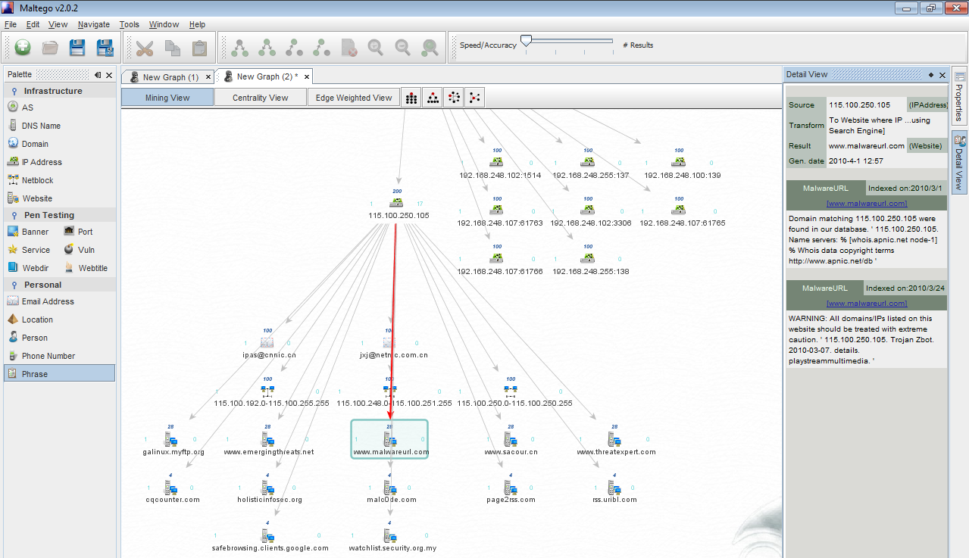
Maltego
CS 6823 - Network Security
23

Slide 24
Individual – Social Network Profile
Metadata Leakage
Tone
Frequency
Location Awareness
Social Media Presense
CS 6823 - Network Security
24

Slide 25
Cree.py is an open source intelligence gathering application.
Can gather from Twitter.
Cree.py can gather any geo-location data from flickr, twitpic.com, yfrog.com, img.ly, plixi.com, twitrpix.com, foleext.com, shozu.com, pickhur.com, moby.to, twitsnaps.com and twitgoo.com.
25

Slide 26
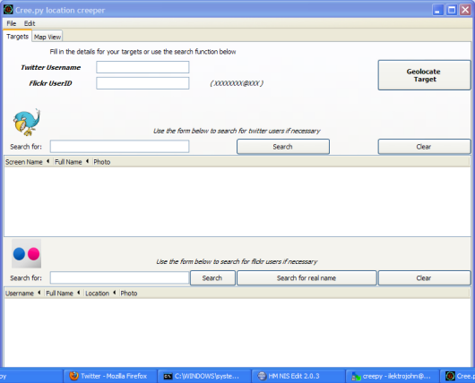
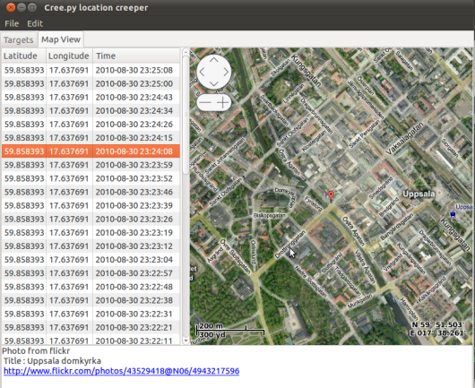
Cree.py
CS 6823 - Network Security
26

Slide 27
Determine the Network Range (Scanning and Enumeration)
CS 6823 - Network Security
27

Slide 28
Network Attack Methodology
Recon – Information gathering
Scanning – Enumeration
Identify Hosts
Vulnerability Identification
Exploitation
Gaining access
Elevating given access
Application/Web level attacks
Denial of Service (DOS)
Post Exploitation –
Maintaining Access
Removing Forensic Evidence
Exfiltration
CS 6823 - Network Security
28
Notes:
route-server>sh ip route 128.238.0.0
Routing entry for 128.238.0.0/16
Known via "bgp 4323", distance 200, metric 0
Tag 7018, type internal
Last update from 168.215.52.202 5d10h ago
Routing Descriptor Blocks:
* 168.215.52.202, from 168.215.52.203, 5d10h ago
Route metric is 0, traffic share count is 1
AS Hops 2
route-server>tracert 128.238.2.92
^
% Invalid input detected at '^' marker.
route-server>trace 128.238.2.92
Type escape sequence to abort.
Tracing the route to duke.poly.edu (128.238.2.92)
1 ge-0-3-0-514.dnvr.twtelecom.net (66.162.47.57) 0 msec 0 msec 0 msec
2 peer-01-so-1-0-0-0.dlfw.twtelecom.net (66.192.246.53) 16 msec 16 msec 16 msec
3 cr2.dlstx.ip.att.net (12.122.138.18) [AS 7018] 52 msec 56 msec 52 msec
4 cr1.attga.ip.att.net (12.122.28.173) [AS 7018] 56 msec 52 msec 56 msec
5 cr2.wswdc.ip.att.net (12.122.1.174) [AS 7018] 56 msec 56 msec 56 msec
6 cr2.n54ny.ip.att.net (12.122.3.37) [AS 7018] 56 msec 56 msec 56 msec
7 gar2.nylny.ip.att.net (12.122.130.49) [AS 7018] 52 msec 56 msec 52 msec
8 12.116.102.22 [AS 7018] 60 msec 56 msec 56 msec
9 42ce7023.unknown.oainc.net (66.206.112.35) [AS 23329] 156 msec 56 msec 56 msec
10 65.77.177.90 [AS 23329] 56 msec 56 msec 60 msec
11 duke.poly.edu (128.238.2.92) [AS 23329] 60 msec 60 msec 60 msec
12 duke.poly.edu (128.238.2.92) [AS 23329] 60 msec 60 msec 60 msec

Slide 29
DNS is a Treasure Trove of Info
When you register a domain name with an authorized registrar you must provide a valid name, address and phone number of the person responsible for the domain.
This information can be used against you in an attack
CS 6823 - Network Security
29

Slide 30
Whois Database
Many website and domain registrars offer this service through the web.
Can also use the built in “whois” command on many Unix systems.
First looks up the target in InterNIC to determine the registrar: http://www.internic.net/whois.html
Then go to the registrar for detailed records:
Ex. http://www.networksolutions.com/whois/index.jsp
CS 6823 - Network Security
30

Slide 31
Also Get Registered IP Blocks
Based on geographical location:
ARIN (American Registry for Internet Numbers)
www.arin.net (https://ws.arin.net/whois/)
RIPE (Reseaux IP Europeans Network Coordination Centre)
www.ripe.net
APNIC (Asia Pacific Network Information Center)
www.apnic.net
LACNIC (Latin American and Caribbean NIC)
www.lacnic.net
AFRINIC (Africa’s NIC)
www.afrinic.net
DoDNIC (Department of Defense NIC)
www.nic.mil - not open to the outside
Other useful sites:
www.allwhois.com www.uwhois.com
CS 6823 - Network Security
31

Slide 32
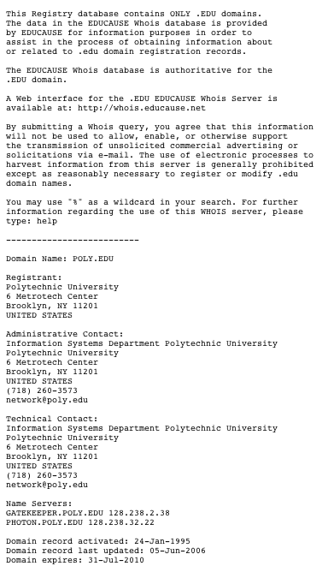
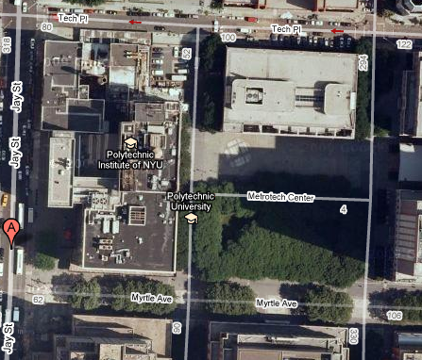

Poly.edu WHOIS Reconnaissance
CS 6823 - Network Security
32

Slide 33
DNS Record Types
A | ADDRESS RECORD. DESCRIBES THE IP ADDRESS THAT A GIVEN NODE HAS
MX | MAIL EXCHANGE. IP ADDRESS OF THE SERVER WHICH HANDLES MAIL FOR THE DOMAIN
NS | NAME SERVER. DOMAIN NAME SERVERS WHICH SERVE THIS DOMAIN NAME
CNAME | CANONICAL NAME. ALIASES FOR HOST NAMES
SOA | FIRST LINE OF DNS FILE. INDICATES THAT THIS SERVER IS THE BEST SOURCE OF INFORMATION FOR THIS DOMAIN
SRV | SERVICE RECORD. INFORMATION ABOUT AVAILABLE SERVICE IN THE DOMAIN. SIP AND XMPP USE THIS.
RP | RESPONSIBLE PERSON. ASSIGN AN EMAIL ADDRESS TO A SPECIFIC HOST
PTR | POINTER RECORD. ALLOWS FOR REVERSE DNS LOOKUP. TYPICALLY REQUIRED FOR MX HOSTS
TXT | ORIGINALLY FOR HUMAN READABLE INFORMATION. BUT NOW USED FOR THINGS SUCH AS DOMAIN-KEYS
HINFO | HOST INFO. SUPPLIES OS AND OTHER INFO ABOUT A HOST. GENERALLY NOT A GOOD IDEA.
CS 6823 - Network Security
33
Notes:
DNS Cache poisioning – DNS server contains false information
DNS Spoofing – third party answering DNS request
Unrelated/related data attack – adding additional data
DNS ID Hacking – trying to reply with the correct ID

Slide 34
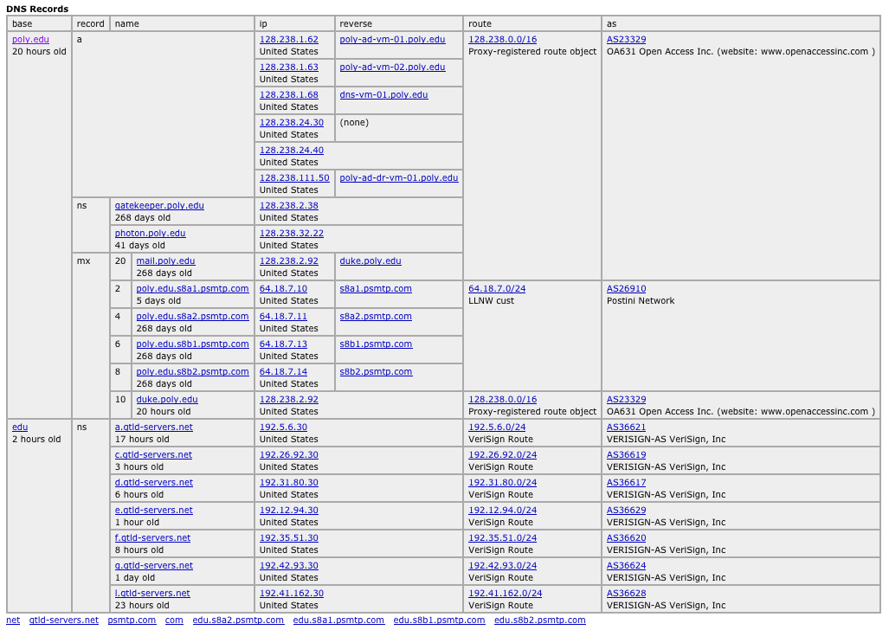
Poly.edu DNS Reconnaissance
CS 6823 - Network Security
34
Notes:
http://network-tools.com/

Slide 35
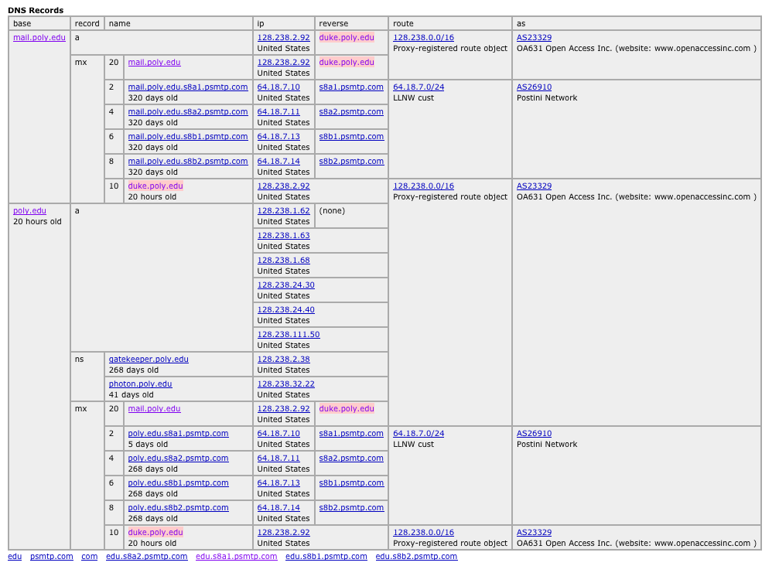
Lets dig into mail.poly.edu:
CS 6823 - Network Security
35

Slide 36
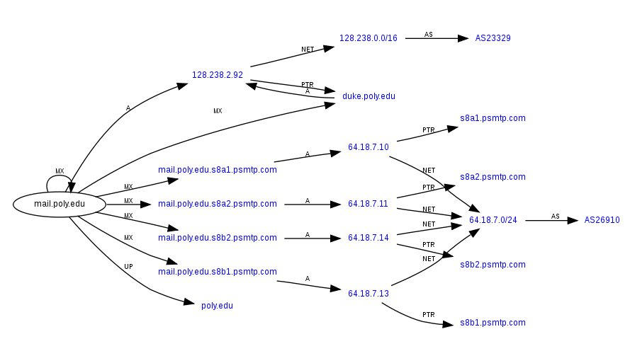
Map of mail.poly.edu
See: http://www.robtex.com
CS 6823 - Network Security
36

Slide 37
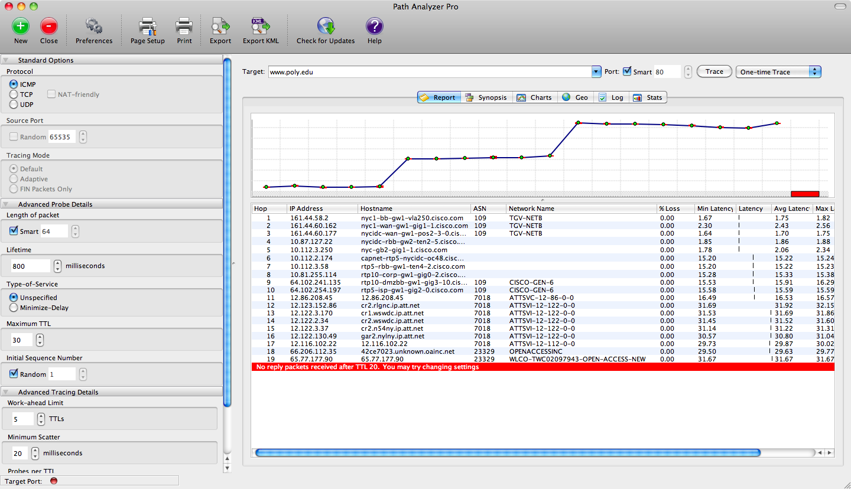
Gather Other Network Information
CS 6823 - Network Security
37
Notes:
Routers, firewalls

Slide 38
BGP “Looking Glass Servers”
home-macpro:~ kobrien$ telnet route-server.twtelecom.net
Trying 66.162.47.58...
Connected to route-server.twtelecom.net.
Escape character is '^]'.
C
************************************************************************
** route-server.twtelecom.net **
** tw twtelecom IP Route Monitor **
** AS 4323 **
************************************************************************
This route server maintains peering sessions with several border
routers within the tw telecom nation wide US network.
168.215.52.101 Atlanta, GA
168.215.52.9 Chicago, IL
168.215.52.192 Denver, CO
168.215.52.175 Los Angeles, CA
168.215.52.70 New York, NY
168.215.52.197 Oakland, CA
168.215.52.203 Seattle, WA
CS 6823 - Network Security
38

Slide 39
BGP “Looking Glass Servers” (cont)
route-server>sh ip route 128.238.0.0
Routing entry for 128.238.0.0/16
Known via "bgp 4323", distance 200, metric 0
Tag 7018, type internal
Last update from 168.215.52.202 5d10h ago
Routing Descriptor Blocks:
* 168.215.52.202, from 168.215.52.203, 5d10h ago
Route metric is 0, traffic share count is 1
AS Hops 2
route-server>tracert 128.238.2.92
^
% Invalid input detected at '^' marker.
route-server>trace 128.238.2.92
Type escape sequence to abort.
Tracing the route to duke.poly.edu (128.238.2.92)
1 ge-0-3-0-514.dnvr.twtelecom.net (66.162.47.57) 0 msec 0 msec 0 msec
2 peer-01-so-1-0-0-0.dlfw.twtelecom.net (66.192.246.53) 16 msec 16 msec 16 msec
3 cr2.dlstx.ip.att.net (12.122.138.18) [AS 7018] 52 msec 56 msec 52 msec
4 cr1.attga.ip.att.net (12.122.28.173) [AS 7018] 56 msec 52 msec 56 msec
5 cr2.wswdc.ip.att.net (12.122.1.174) [AS 7018] 56 msec 56 msec 56 msec
6 cr2.n54ny.ip.att.net (12.122.3.37) [AS 7018] 56 msec 56 msec 56 msec
7 gar2.nylny.ip.att.net (12.122.130.49) [AS 7018] 52 msec 56 msec 52 msec
8 12.116.102.22 [AS 7018] 60 msec 56 msec 56 msec
9 42ce7023.unknown.oainc.net (66.206.112.35) [AS 23329] 156 msec 56 msec 56 msec
10 65.77.177.90 [AS 23329] 56 msec 56 msec 60 msec
11 duke.poly.edu (128.238.2.92) [AS 23329] 60 msec 60 msec 60 msec
12 duke.poly.edu (128.238.2.92) [AS 23329] 60 msec 60 msec 60 msec
CS 6823 - Network Security
39
Notes:
Firewalls, internal routers

Slide 40
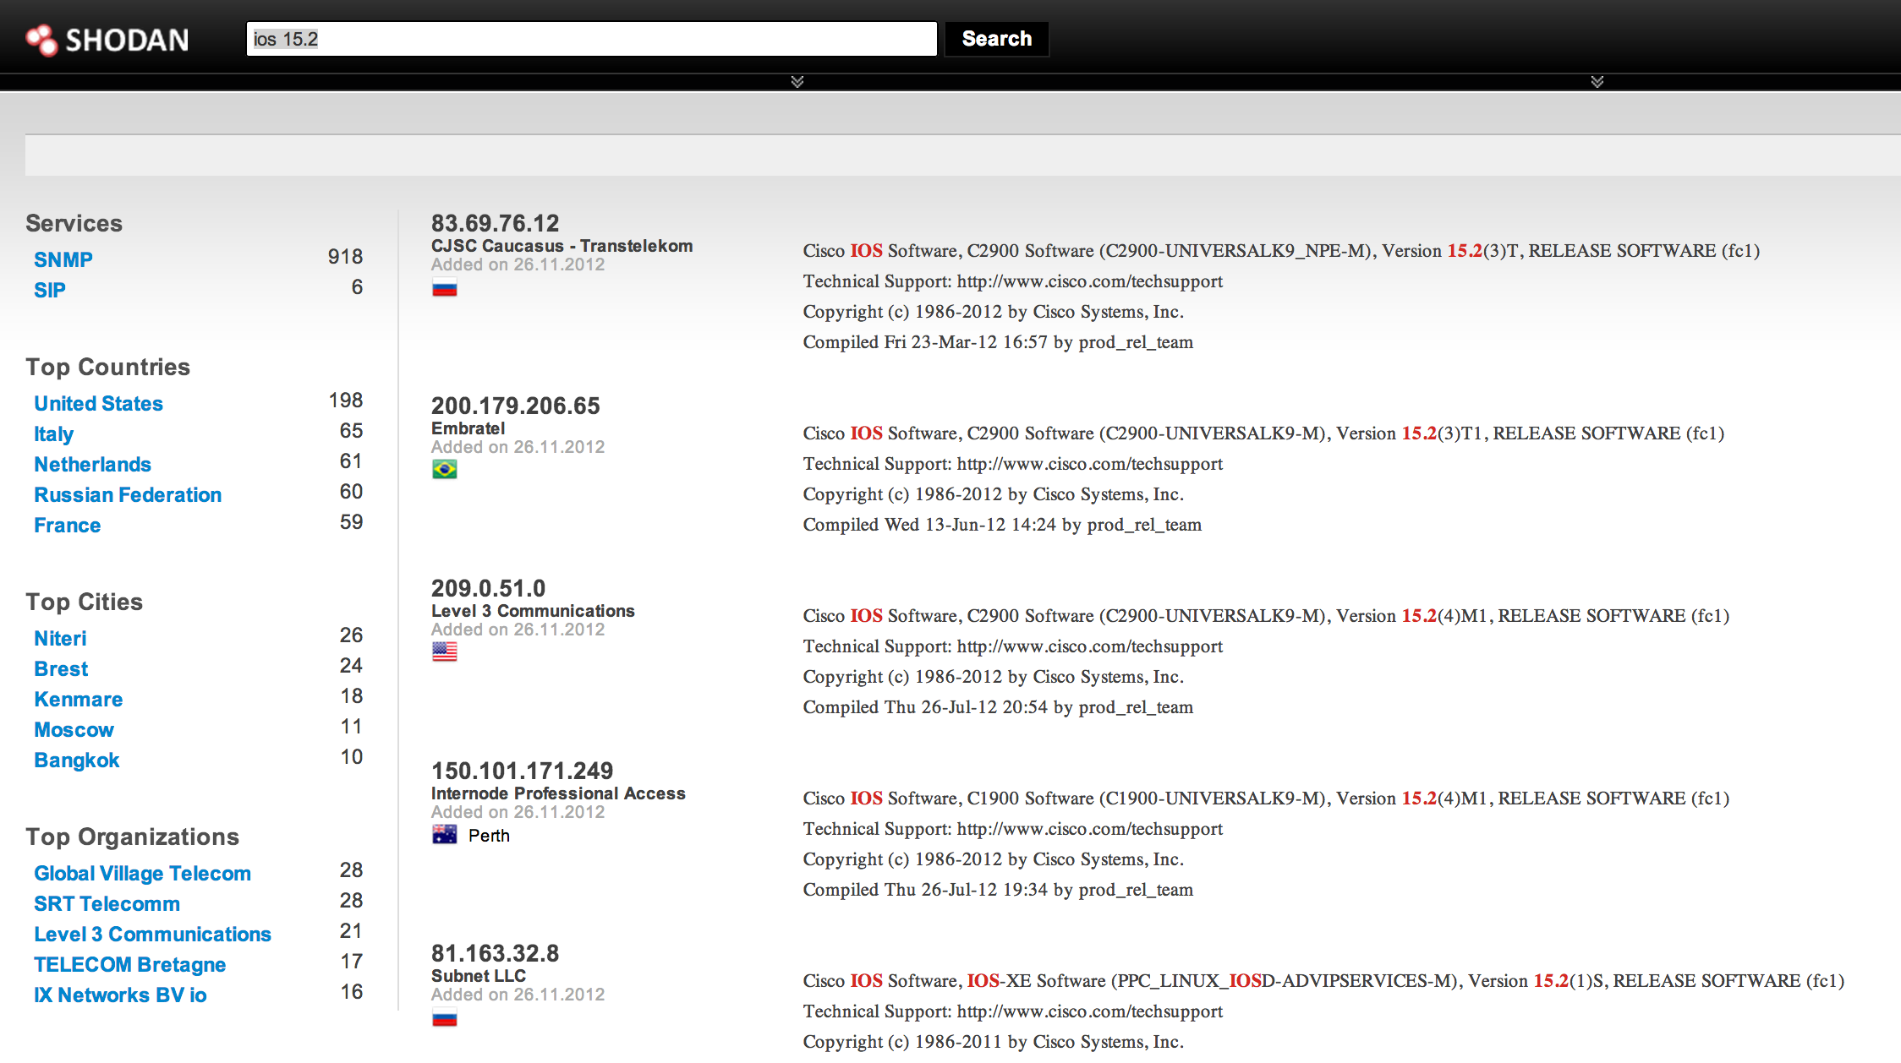
Shodan
CS 6823 - Network Security
40

Slide 41
Identify Hosts
CS 6823 - Network Security
41

Slide 42
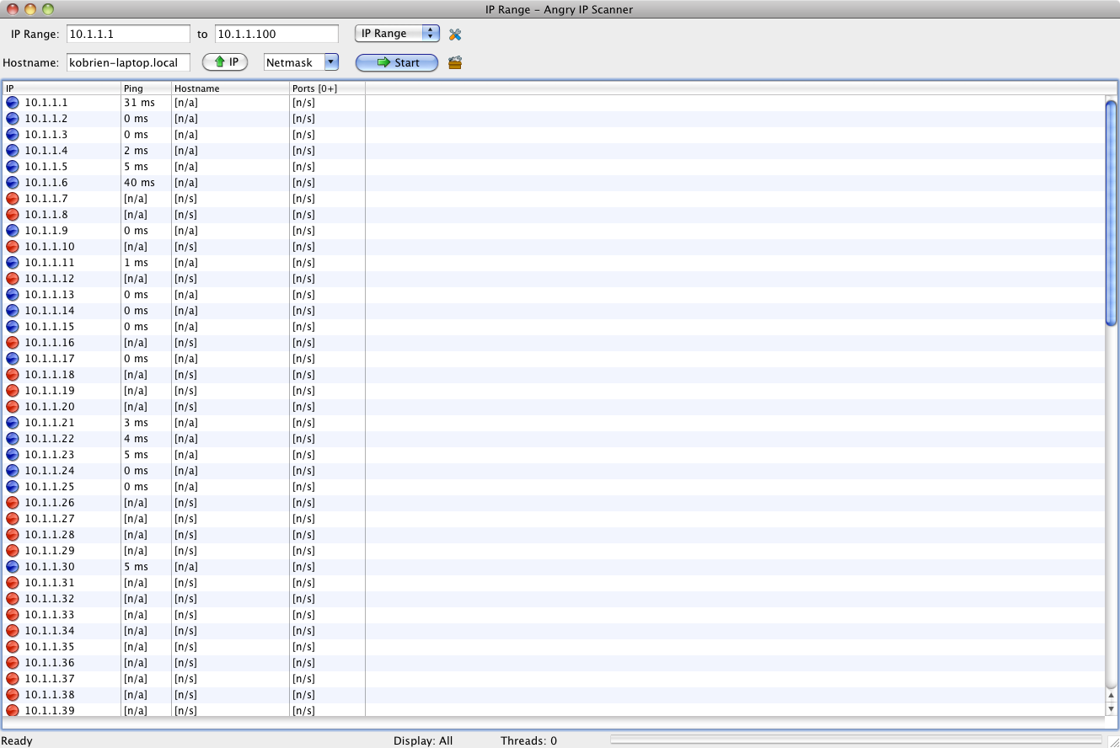
Ping Sweep – IP Scanner
CS 6823 - Network Security
42

Slide 43
DNS Zone Transfer
On Linux systems dig can be used to perform a zone transfer from a DNS server.
Very useful in recon and identifying targets.
dig @[DNS_server_IP] {target_domain] –t AXFR
kobrien@ubuntu-vm:~$ dig @10.1.1.3 example.org-t AXFR
; <<>> DiG 9.6.1-P2 <<>> @10.1.1.3 example.org -t AXFR
; (1 server found)
;; global options: +cmd
example.org. 38400 IN SOA ns.example.org.example.org. admin.example.org.example.org. 2008090354 10800 3600 604800 86400
example.org. 38400 IN NS ns.example.org.
smtp.example.org. 38400 IN CNAME winserver.example.org.
switch.example.org. 38400 IN A 10.1.1.2
linuxserv.example.org. 38400 IN A 10.1.1.67
vmware.example.org. 38400 IN A 10.1.1.25
winserver.example.org. 38400 IN A 10.1.1.26
winserver-ca.example.org. 38400 IN CNAME winserver.example.org.
wireless.example.org. 38400 IN A 10.1.1.14
example.org. 38400 IN SOA ns.example.org.example.org. admin.example.org.example.org. 2008090354 10800 3600 604800 86400
;; Query time: 18 msec
;; SERVER: 10.1.1.3#53(10.1.1.3)
;; WHEN: Tue Jan 26 10:55:54 2010
;; XFR size: 33 records (messages 1, bytes 840)
CS 6823 - Network Security
43
Notes:
Exposure of internal server names

Slide 44
Brute Force Forward DNS
Many scripts and tools to do this (example: dns-map).
Relies on the method of taking a database of common host names and performing forward lookup.
bt-netbook:/pentest/enumeration/dns/dnsmap# ./dnsmap example.org
dnsmap 0.22.2 - DNS Network Mapper by pagvac (gnucitizen.org)
[+] searching (sub)domains for obrienhome.org using built-in wordlist
firewall.example.org
IP address #1: 10.10.10.1
ftp.example.org
IP address #1: 10.10.10.3
ns.example.org
IP address #1: 10.10.10.3
smtp.example.org
IP address #1: 10.10.10.10
vpn.example.org
IP address #1: 10.10.10.1
CS 6823 - Network Security
44

Slide 45
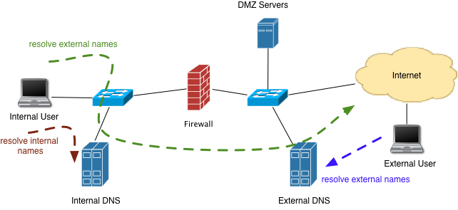
Split DNS
External DNS has info on DMZ servers.
Internal DNS has info on internal servers.
Prevents leakage of internal DNS information
CS 6823 - Network Security
45

Slide 46
Finding Open Ports
CS 6823 - Network Security
46

Slide 47
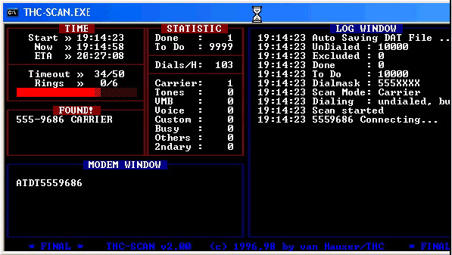
War Dialing
War dialers dial a sequence of phone numbers searching for modems or open PBXs
Modems are still prevalent for remote management of network equipment and infrastructure
Often they are left unprotected
CS 6823 - Network Security
47

Slide 48
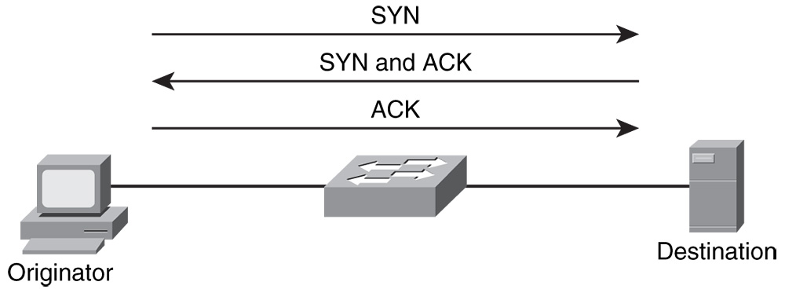
Port Scanning
Port scanners send TCP and UDP packets to various ports to determine if a process is active
TCP 80 (web server)
TCP 23 (telnet server)
UDP 53 (DNS server)
TCP scanning based on 3 way handshake
CS 6823 - Network Security
48

Slide 49
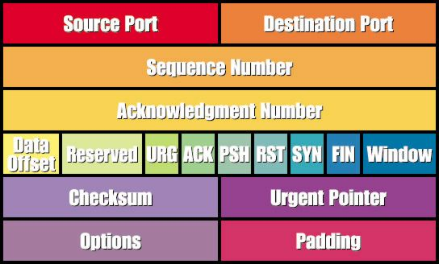
TCP Control Bits
SYN – Synchronize
ACK – Acknowledgement
FIN – End a connection
RESET – Tear down a connection
URG – Urgent data is included
PUSH – Data should be pushed through the TCP stack
CS 6823 - Network Security
49

Slide 50
HPING
Runs on all Unix-like systems. Also windows version.
Completely scriptable using TCL.
Can be used to write scripts implementing low level packet manipulation very quickly.
Example:
hping3 -I en1 -S 10.1.1.1 -p 443 (sends packet to port 443 with SYN flag)
Hping3 –l en1 –S 10.1.1.1 -p ++79 (sends packet with SYN flag. Increments by 1 starting at 79.)
CS 6823 - Network Security
50

Slide 51
HPING Switches (selected – see - - help)
-F --fin
-S --syn
-R --rst
-P --push
-A --ack
-U –urg
-s --baseport
-p –destport
-k --keep
-w --win
-O –tcpoff
-Q --seqnum
-b –badcksum
-M --setseq
-L --setack
CS 6823 - Network Security
51

Slide 52
HPING
Can also craft the payload of packets.
Useful for testing IPS/IDS systems.
# cat /root/signature.sig ""BUFFER OVERFLOW”
# hping -2 -p 7 10.1.1.1 -d 50 -E /root/signature.sig
HPING 192.168.10.33 (eth0 192.168.10.33): udp mode set, 28 headers + 50 data bytes
len=78 ip=192.168.10.33 seq=0 ttl=128 id=24842 rtt=4.9 ms
len=78 ip=192.168.10.33 seq=1 ttl=128 id=24844 rtt=1.6 ms
len=78 ip=192.168.10.33 seq=2 ttl=128 id=24846 rtt=1.0 ms
--- 192.168.10.33 hping statistic ---
3 packets tramitted, 3 packets received, 0% packet loss
round-trip min/avg/max = 1.0/2.5/4.9 ms
CS 6823 - Network Security
52

Slide 53

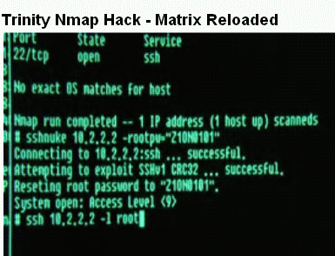
NMAP
Very popular port scanning tool
Written by “Fodor. http://insecure.org/nmap
Runs on Unix or Windows
GUI available (nmapfe)
CS 6823 - Network Security
53

Slide 54
NMAP – Scan Types
TCP Connect scan - This type of scan is the most reliable, although it is also the most detectable. It is easily logged and detected because a full connection is established. Open ports reply with a SYN/ACK, whereas closed ports respond with an RST/ACK. Uses standard connect() system call.
TCP SYN scan - This type of scan is known as half open because a full TCP three-way connection is not established. This type of scan was originally developed to be stealthy and evade IDS systems although most now detect it. Open ports reply with a SYN/ACK, whereas closed ports respond with a RST/ACK.
TCP FIN scan - This type of scan sends a FIN packet to the target port. Closed ports should send back an RST. This technique is usually effective only on UNIX devices.
TCP NULL scan - a NULL scan sends a packet with no flags set. If the OS has implemented TCP per RFC 793, closed ports will return an RST.
TCP ACK scan - This scan attempts to determine firewall access control list (ACL) rule sets or identify if stateless inspection is being used. If an ICMP destination unreachable, communication administrative prohibited message is returned, the port is considered to be filtered.
CS 6823 - Network Security
54
Notes:
SYN -> SYN/ACK,RST and ACK -> RST, the port is unfiltered by any firewall type
SYN -> SYN/ACK, ACK -> nothing, the port is statefully filtered.
SYN -> no SYN/ACK and no RST, ACK -> RST, the port is statefully filtered
When neither SYN nor ACK generates any response, the port is blocked by a specific firewall rule

Slide 55
NMAP Scan Types (cont)
TCP XMAS - port scan that has toggled on the FIN, URG, and PSH flags. Closed ports should return an RST.
FTP Proxy “bounce attack” scans – bounce an attack off a poorly configured FTP server
Version Scanning – tries to determine the version number of the program listening on the port
Fragmented Scans – can get around some router ACL packet filters that do not examine the port number in fragmented packets.
TCP Sequence Prediction – useful in spoofing attacks
CS 6823 - Network Security
55

Slide 56
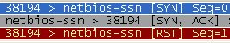
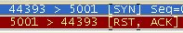
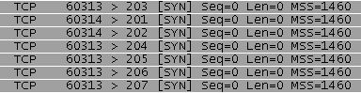
TCP SYN Scan
Client SYN → Server
Client ← SYN/ACK Server
Client RST → Server
The server is ready but the client never completes the handshake.
Somewhat stealthy since session handshake is not completed which keeps it out of some log files
Closed
Open
Filtered
CS 6823 - Network Security
56

Slide 57
NMAP – ACK Scanning
Some firewalls may allow for outgoing SYN connections and their incoming responses with the ACK bit set.
Stateful firewalls maintain the state of the SYN and ACK packets and will only allow an ACK inbound if there is an outstanding SYN packet.
Can be useful for network mapping
CS 6823 - Network Security
57

Slide 58
NMAP – FTP Bounce Scan
RFC 959 defines a “feature” in FTP which allows for FTP proxy connections.
Essentially I can connect to a FTP and request the server to send a file to a client.
This should be disabled on properly configured FTP servers.
Can be used on misconfigured FTP server to bounce a scan off the server thereby hiding the attackers location.
Use “port” command to try and list directory. If target is listening on the port it will respond with a 150 or 226 response
If the port is not listening or closed it will respond with “425 Can't build data connection: Connection refused.”
Useful to get around firewalls if firewall allows connection to FTP server.
CS 6823 - Network Security
58

Slide 59
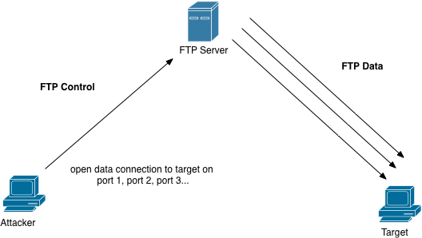
FTP Bounce Scan
CS 6823 - Network Security
59

Slide 60
IDLE Scan (Hide the Scan Source)
Normal port scans send TCP SYN packets to the target and wait for a SYN-ACK
Problem with this is that the attacker is easily identified
If the attacker Spoofs their source IP address then the attacker doesn't’t receive the results of the scan.
Use the IP Identification Field of the IP Header.
Normally used to group fragments of IP packets together
Most operating systems increment the IP Ident field by one for each packet sent.
CS 6823 - Network Security
60

Slide 61
IDLE Scan (cont)
Attacker first picks the machine which will be “framed” for the attack.
Attacker sends a SYN packet to the “framed” machine
Attacker gets back a SYN-ACK which will include the IP header with IP ID value of X which is remembered by the attacker.
Next step is the attacker selects the port to be scanned and sends a spoofed SYN packet to the target with the “framed” machine’s ip.
If listening the target will send a SYN-ACK back to the framed machine
When the “framed” machine receives a SYN-ACK from the target which was never requested it will send a RESET. The IP ID field on the “framed” machine will be X+1
Attacker now “measures” the IP ID field on the “framed” machine. Sends SYN. If gets IP ID value of X+2 then port is open. If IP ID is X+1 then it is closed
CS 6823 - Network Security
61

Slide 62
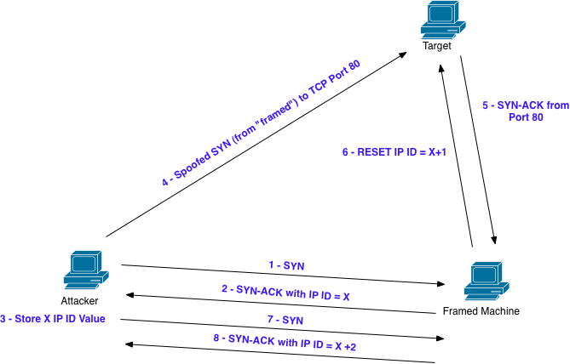
IDLE Scan (cont)
CS 6823 - Network Security
62
Notes:
http://nmap.org/book/idlescan.html

Slide 63
Useful NMAP Command with OS Fingerprinting
nmap -sV -O -sC --top-ports 100 -T4 -oA [file] [address]
nmap -sV -O -sC --top-ports 100 -T4 -oA out.txt 10.1.1.0/24
-sV -Probe open ports to determine service-/version info
-O -Enable OS detection
-sC -Enable Script scanning
--top-ports -Only scan “popular ports”
-T4 -Sets template for fast scans (0 slow – 5 fast)
-oA -Output file
CS 6823 - Network Security

Slide 64
Firewalk
Firewalk is a network scanning tool which attempts to determine which layer3/4 ACLs are present on filtering routers and firewalls.
Sends out TCP and UDP packets with a TTL on greater than the targeted firewall.
If the firewall allows the traffic it will forward to the internal host or next hop where it will expire and return an ICMP_TIME_EXCEEDED message.
If the firewalls drops the traffic no response will be received.
firewalk -p [protocol] -d [destination_port] -s [source_port] [internal_IP] [gateway_IP]
root@fc4>firewalk -n -p tcp -s 80 -d 80 192.168.0.1 192.168.1.1 Firewalk 5.0 [gateway ACL scanner] Firewalk state initialization completed successfully. TCP-based scan. Ramping phase source port: 80, destination port: 80 Hotfoot through 192.168.0.1 using 192.168.1.1 as a metric. Ramping Phase: expired [192.168.0.1] Binding host reached. Scan bound at 2 hops. Scanning Phase: A! open (port not listen) [192.168.1.1] A! open (port not listen) [192.168.1.1] A! open (port not listen) [192.168.1.1] A! open (port not listen) [192.168.1.1] A! open (port listen) [192.168.1.1]
CS 6823 - Network Security

Slide 65
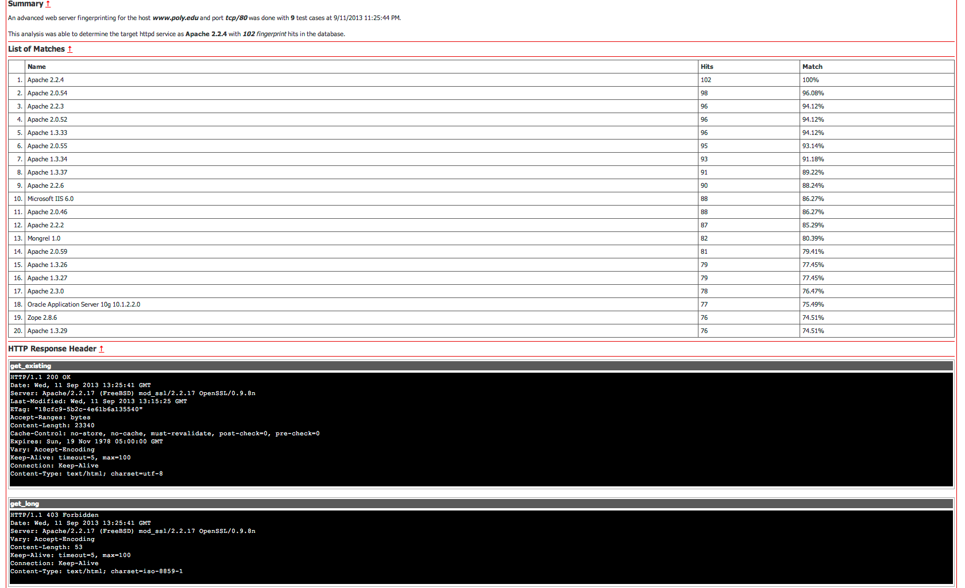
httprecon – Web Server Fingerprinting
CS 6823 - Network Security
65

Slide 66
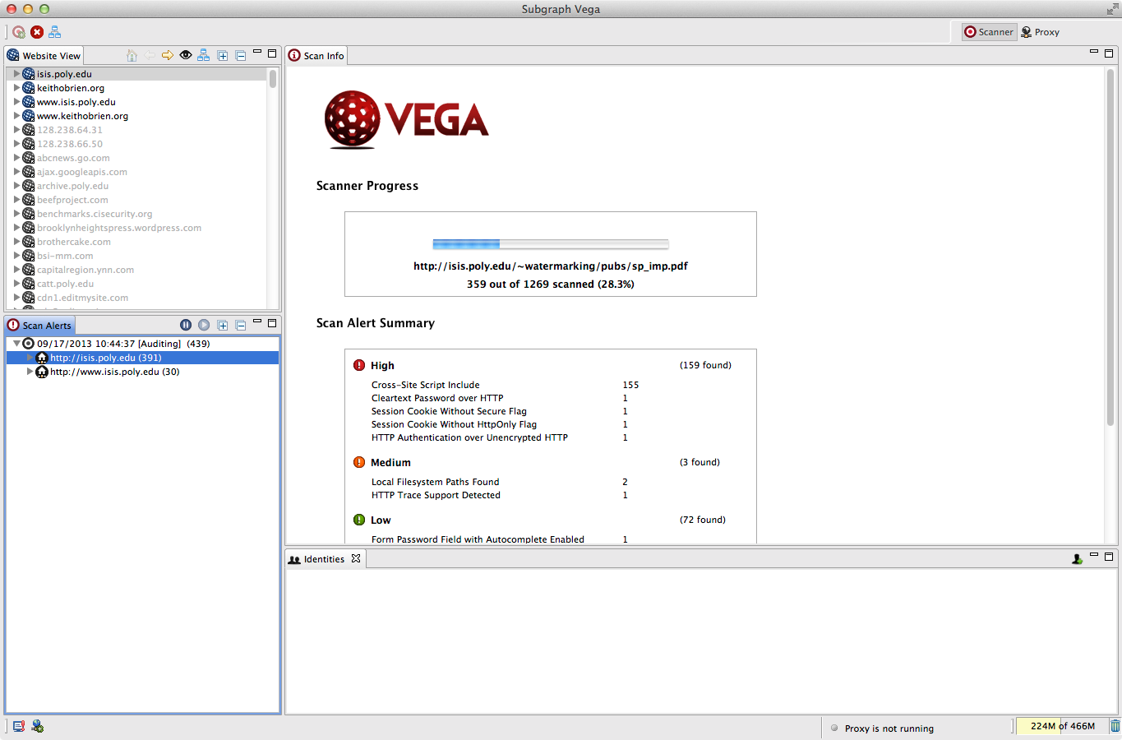
Vega – Web App Vulnerability Checks
CS 6823 - Network Security
66

Slide 67
Map the Network
At the point you should have enough information to map our the network.
This is a critically important part as during a penetration test it would be referred to frequently.
Recursion
After the completion of all steps of the reconnaissance process, the assessor needs to analyze the data and go through all the steps again with new data.
4
3
Service
Discovery
2
Host
Discovery
1
Network
Discovery
5
Public
Information
Sources
Network Mapping and Analysis
Process
Analysis
6
Recursion
CS 6823 - Network Security

Slide 68
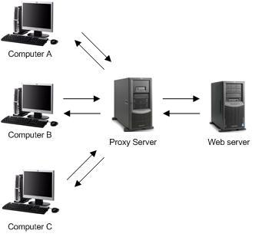
Staying Anonymous
Proxy Servers
Works at the application layer
For web proxies the proxy server terminates the http request on the server and then re-originates it.
Used in organizations for outbound web access in order to restrict and monitor web surfing.
Can also be used to anonymize connections
CS 6823 - Network Security

Slide 69
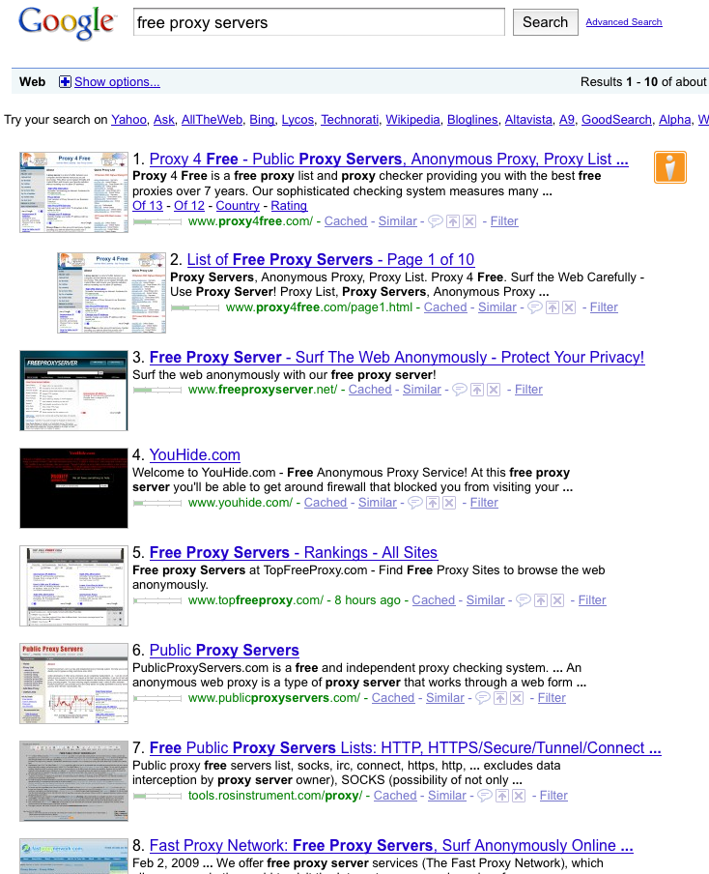
Anonymizing Proxies
Thousands of free proxy servers are available.
Be careful some are run by blackhats and can be used to steal your traffic.
Can chain proxies together to back back tracing more difficult.
CS 6823 - Network Security

Slide 70
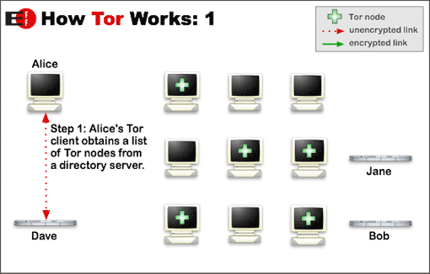
TOR
Tor is a network of virtual tunnels connected together and works like a big chained proxy
Tor uses random set of servers every time a user visits a site
CS 6823 - Network Security

Slide 71
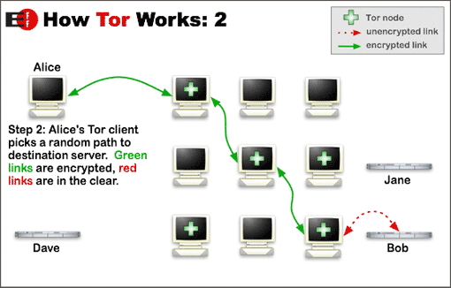
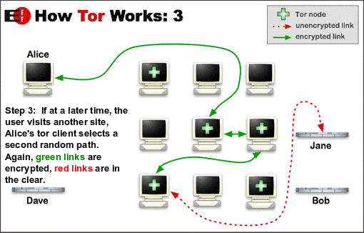
TOR (cont)
CS 6823 - Network Security

Slide 72
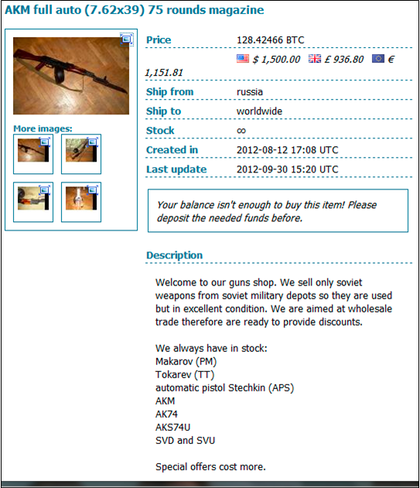
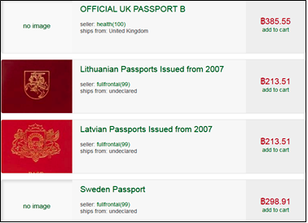
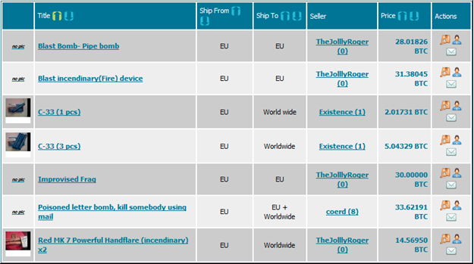

But it Also Has its Own Underground
Websites only accessible from within the TOR network
.onion URL
Example: http://gjrg9qghh.onion
Source of website is anonymized

Slide 73
Summary
At this point we have performed complete reconnaisance on the target network and should have good understand of what is running in the network and how it is designed.
Next step is scanning for vulnerabilities which we will cover in the next lecture
CS 6823 - Network Security

